Slide 1

Unix Programming
JOHN WESILY CHAPPIDI
Johnwesily.ch@vitap.ac.in

Slide 2
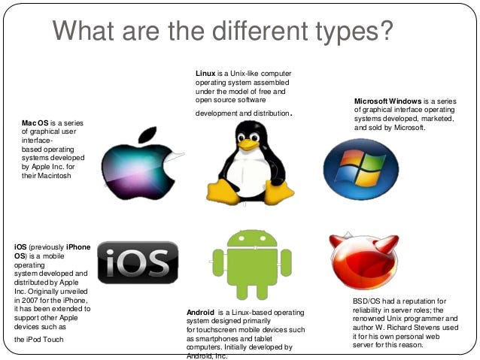
Operating System
Operating System:
An operating system (OS) is a software program that manages and controls the basic functions of a computer.
It serves as an interface between the computer hardware and the user, facilitating the execution of various software applications and providing an environment for them to run.

Slide 3
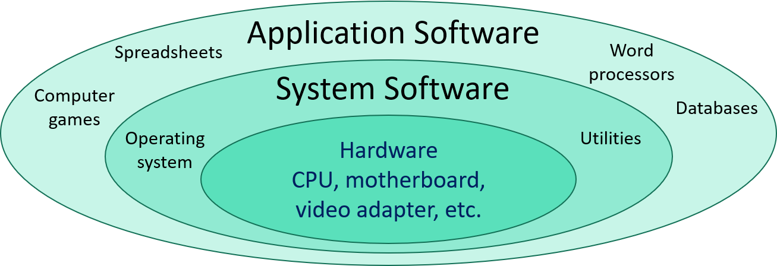
OS Functions
Process Management: The OS manages processes (individual tasks or programs) and allocates system resources such as CPU time, memory, and input/output devices to them, ensuring smooth multitasking and efficient resource utilization.
Memory Management: The OS controls the allocation, utilization, and de-allocation of computer memory to ensure that each application has enough memory to run efficiently without interfering with other processes.
File System Management: The OS organizes and manages files and directories on storage devices, such as hard drives or solid-state drives, facilitating data storage, retrieval, and organization.
Device Management: The OS interacts with hardware devices like printers, scanners, keyboards, and monitors, ensuring that they function correctly and that software applications can use them seamlessly.
User Interface: The OS provides a user-friendly interface through which users can interact with the computer system, either through a graphical user interface (GUI) or a command-line interface (CLI).
Security: Operating systems implement security measures to protect the system and data from unauthorized access and potential threats like viruses, malware, and unauthorized users.

Slide 4

UNIX Operating System
Some of the key features of UNIX include:
Multiuser support: UNIX allows multiple users to simultaneously access the same system and share resources.
Multitasking: UNIX is capable of running multiple processes at the same time.
Shell scripting: UNIX provides a powerful scripting language that allows users to automate tasks.
Security: UNIX has a robust security model that includes file permissions, user accounts, and network security features.
Portability: UNIX can run on a wide variety of hardware platforms, from small embedded systems to large mainframe computers.

Slide 5
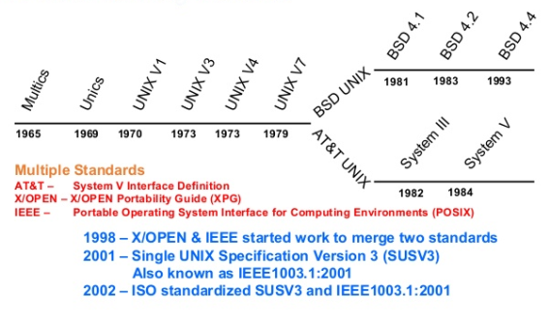
History
Multics:
Multics (Multiplexed Information and Computing Service) ambitious time-sharing OS. It was a joint project by MIT (Massachusetts Institute of Technology), Bell Labs, and General Electric.
UNICS (Unimplied Operating and Computing System) was initially developed at AT&T's Bell Labs in the late 1960s by Ken Thompson, Dennis Ritchie, Brian Kernighan, and others.
Unix Version 7 (1979) Introduced 'csh' (C Shell) as an alternative shell.
The Berkeley Software Distribution (BSD) branch emerged. BSD Unix added features like TCP/IP networking and virtual memory.
BSD and System V: In the late 1970s, the Unix codebase split into two main branches: Berkeley Software Distribution (BSD) and System V (SVR4) from AT&T. BSD focused on openness and collaborative development, while System V was commercially oriented.
The 1980s saw the rise of Unix workstations from Sun, IBM, HP, etc. Workstations became popular for engineering, scientific, and graphics applications.
GNU and Linux: In the 1980s, Richard Stallman founded the GNU project, an initiative to develop a free Unix-like operating system. In the 1990s, Linus Torvalds created the Linux kernel, which, when combined with the GNU tools, resulted in a complete, free, and open-source Unix-like operating system, commonly referred to as "Linux.“
Modern Unix Systems:

